Slide 1

Summarize and sentiment analysis of news articles
Department of Computer Science and
Engineering
Mini Project Review
Batch no:B19
Project Team Members :
19891A0561 ANANTHULA SHESHANTH REDDY
19891A0574 C VIVEK KARTIK
19891A05A9 S KEERTHI
Under the Guidance of
MR.B.SRINU
Associate Professor
CSE

Slide 2
Abstract :
We generally access these documents and resources by Uniform Resource Locators (URLs) over the Internet. There was a time when people used to wait for newspapers in order to catch the previous day’s happenings but thanks to the internet, all the latest information is now available with a click of a button. However, the information is much larger than one can manage quickly and efficiently. Also today everyone wants to gain more information in less time. Instead of reading large documents and then getting the insight, it is better to read a summary that gives the core information about the topic and helps in gaining more information in less time. News reports events that comprise of emotions – good, bad, neutral. Sentiment analysis is utilized to investigate human emotions (i.e., sentiments) present in textual information.

Slide 3
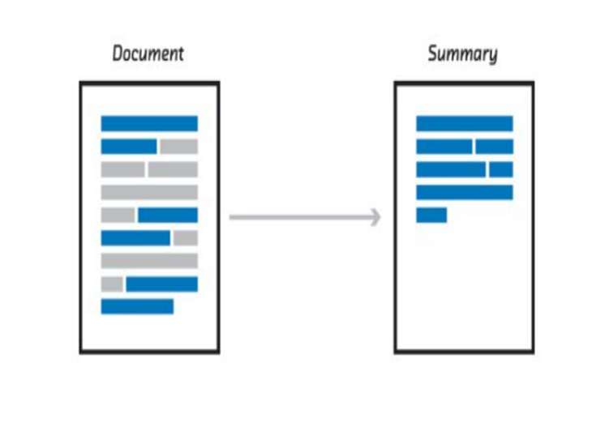
Introduction
We are getting used to the fact that algorithms are increasingly affecting our daily life. This process will undoubtedly make modern people more effective in time management. For this reason, it is inevitable to experience drastic and dizzying changes inhabits.

Slide 4
SYSTEM REQUIREMENTS
SOFWARE REQUIREMENTS:
Operating System: Windows 10 or greater
Software : Python,HTML.
Additional requirements : textblob,newspaper3k, Numpy.
HARDWARE REQUIREMENTS:
Processor: Minimum 1 GHz; Recommended 2GHz or more
Hard Drive: Minimum 32 GB; Recommended 64 GB or more.
Memory (RAM): Minimum 2 GB; recommended 4 GB or above.

Slide 5
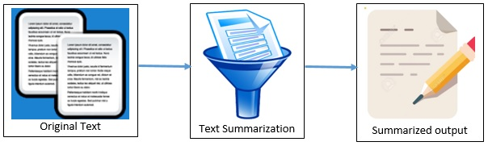
Proposed systems
We devote most of our active time to our compulsory work and study environment. When we find the opportunity, we need technologies that give us more ideal times for leisure activities and hobbies. In this article, we will try to create an NLP project with Python. What we’re going to do is convert information from any news source (we’ll basically use the news link on a website) into the short text to provide a superficial and multiple reading.

Slide 6
MODULES
NEWSPAPER3K
Python library used for Web Scraping articles, It is built on top of requests and for parsing html. This module is a modified and better version of the Newspaper module which is also used for the same purpose
2. NLTK
NLTK, or Natural Language Toolkit, is a Python package that you can use for NLP. A lot of the data that you could be analyzing is unstructured data and contains human-readable text. Before you can analyze that data programmatically, you first need to preprocess it.

Slide 7
3. TEXTBLOB
As TextBlob is a Lexicon-based sentiment analyzer It has some predefined rules or we can say word and weight dictionary, where it has some scores that help to calculate a sentence's polarity. That's why the Lexicon-based sentiment analyzers are also called “Rule-based sentiment analyzers”
4. TKINTER
Tkinter is the standard GUI library for Python. Python when combined with Tkinter provides a fast and easy way to create GUI applications. Tkinter provides a powerful object-oriented interface to the Tk GUI toolkit.

Slide 8
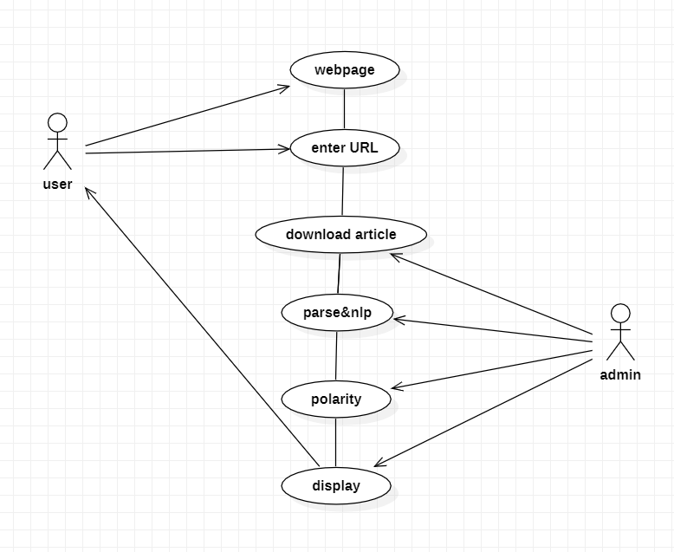
System design
use case diagram:

Slide 9
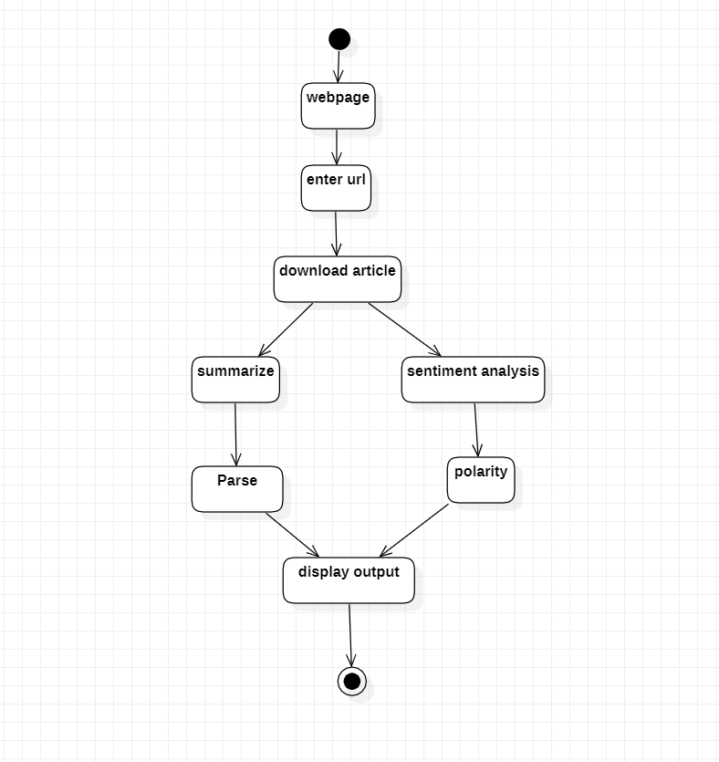
System design
Activity diagram:

Slide 10
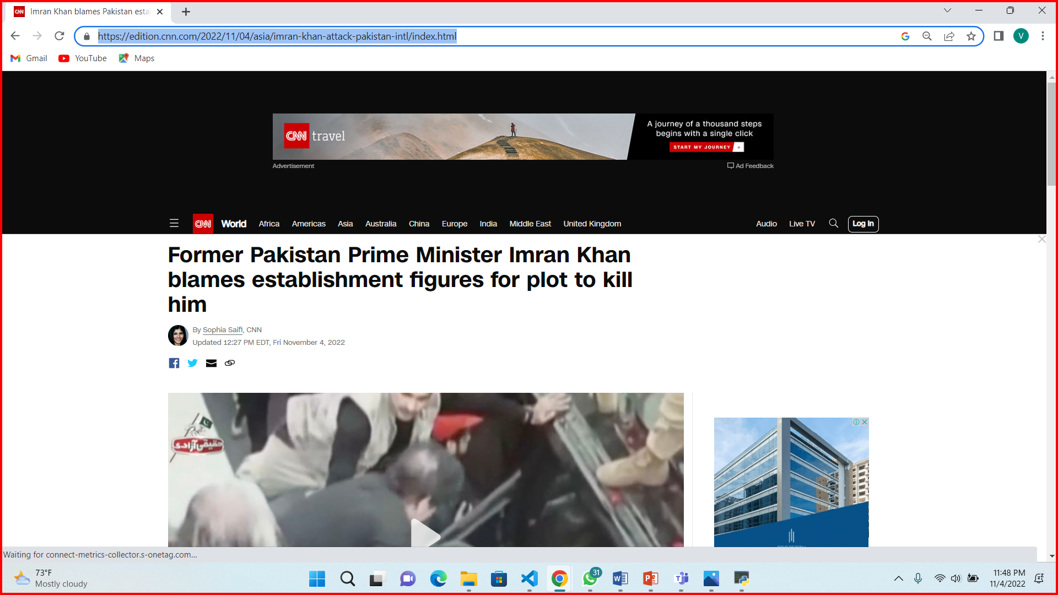
Users procedure
User has to copy the url
1:

Slide 11
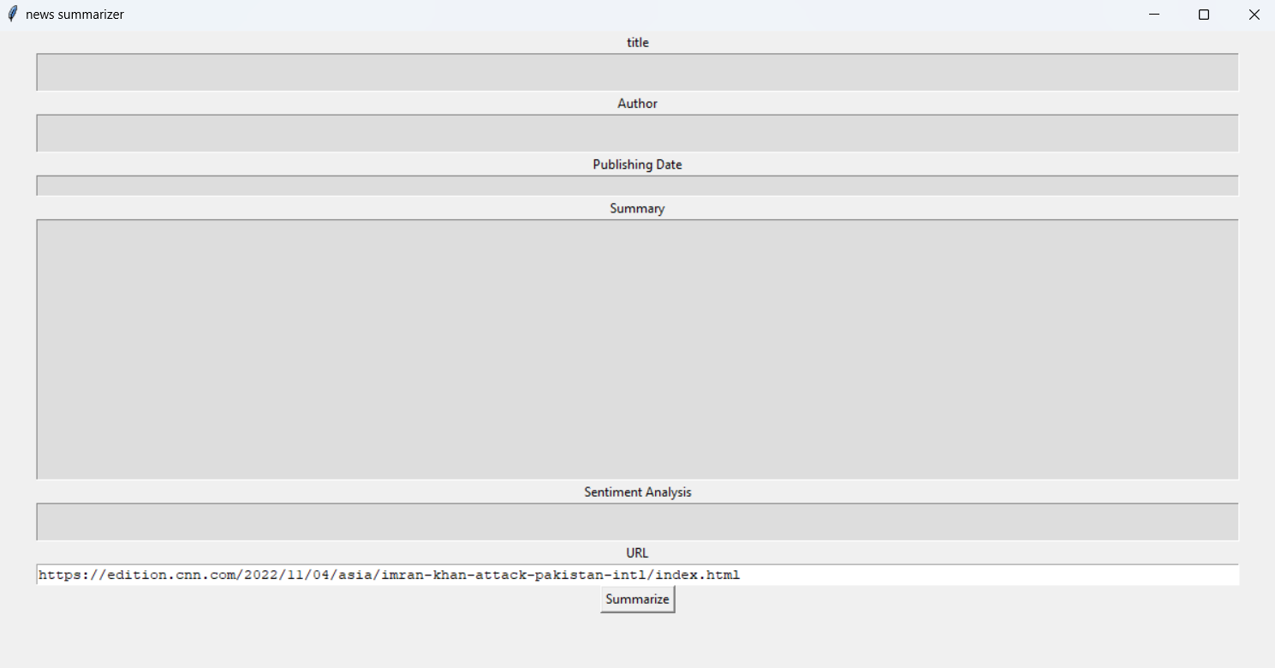
User has to place the url here
2:
Then has submit this button

Slide 12
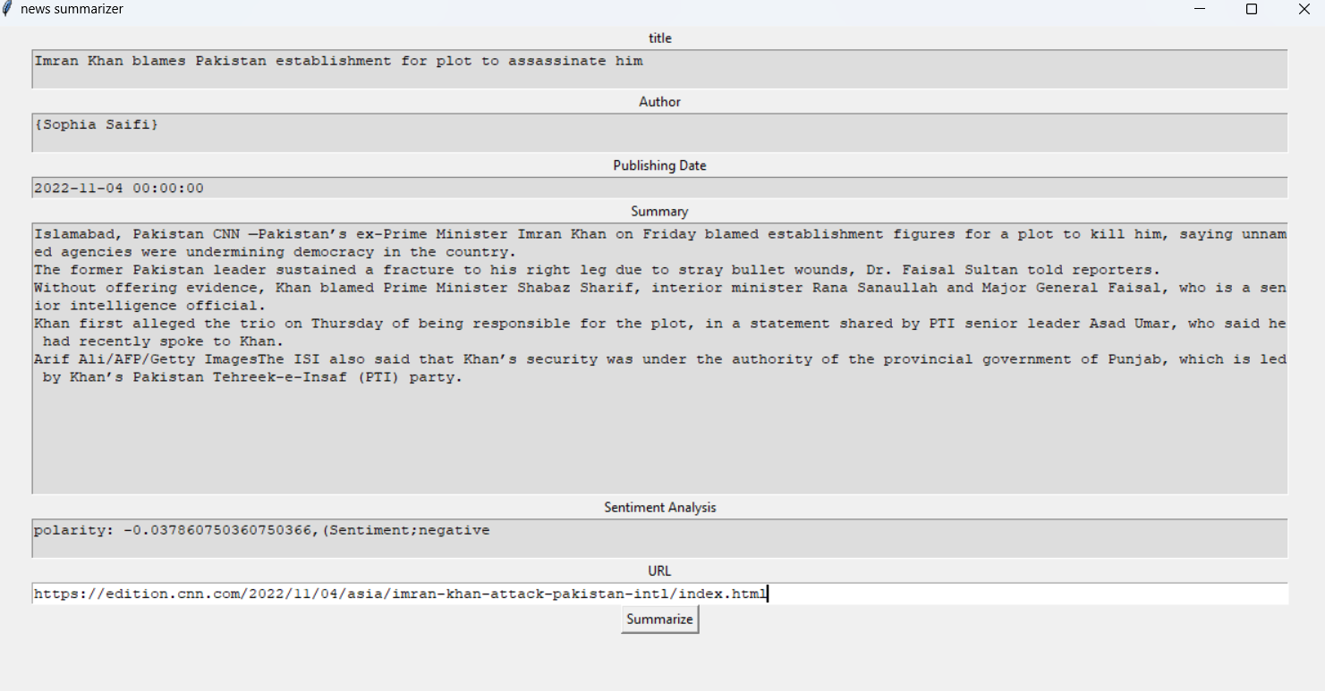
3:
Here the user can read the summary of the article

Slide 13
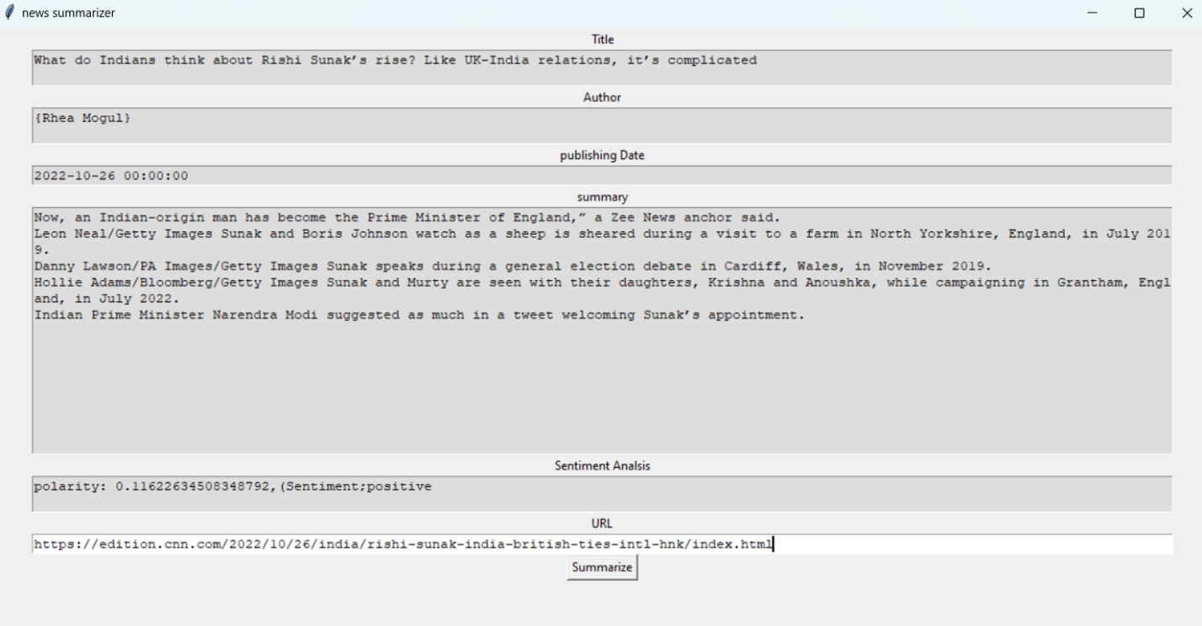
TEST CASES:
6.1-Test case 1:
If we place a positively sentimented articles url then;
We well get the best summary and sentiment degree of the article
The url:
https://edition.cnn.com/2022/10/26/india/rishi-sunak-india-british-ties-intl-hnk/index.html
The output:

Slide 14
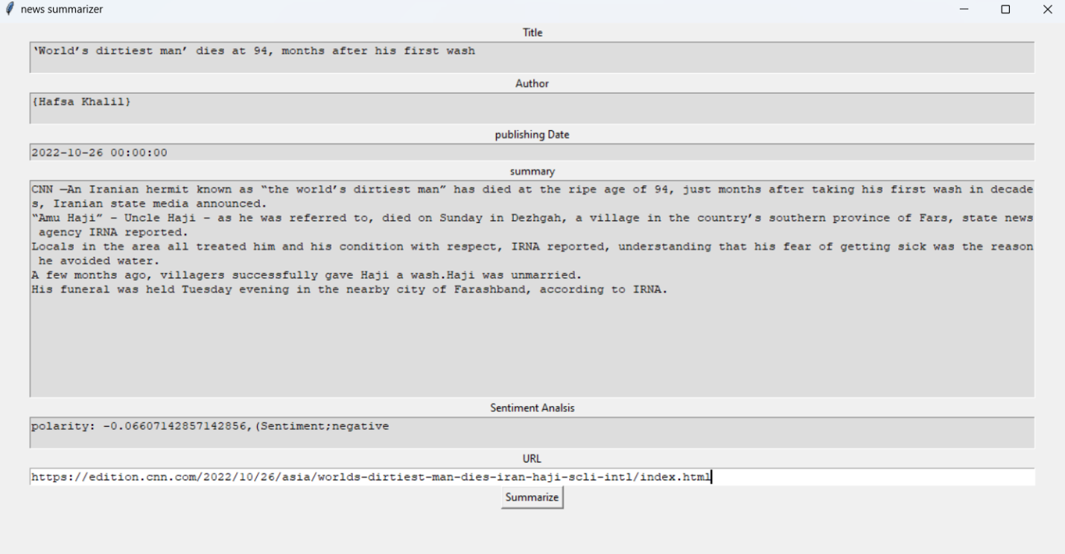
Test case 2:
If we place a negatively sentimented articles url then;
We well get the best summary and sentiment degree of the article
The url:
https://edition.cnn.com/2022/10/26/asia/worlds-dirtiest-man-dies-iran-haji-scli-intl/index.html
the output:

Slide 15
REFERENCES
M. Karlsson, The immediacy of online news, the visibility of journalistic processes and a restructuring of journalistic authority. Journalism, 12(3), 279-295, 2011.
M. U. Islam, F. B. Ashraf, A. I. Abir and M. A. Mottalib, "Polarity detection of online news articles based on sentence structure and dynamic dictionary," 2017 20th International Conference of Computer and Information Technology (ICCIT), Dhaka, 2017, pp. 1-5. doi: 10.1109/ICCITECHN.2017.8281777
Wiki pedia

Slide 16
CONCLUSION
In conclusion, This research shows the statistical-based algorithms can be used to generate fast and decent summaries. As more breakthrough research papers are published in the field of neural networks and the field of NLP and with hardware improvements (CPU + GPU), text summarization shall get more and more reliable. As the information that is being shared online increases every year and with more people spending their time on the internet, text summarization will be widely used to enhance both the user experience and the data delivery. There are ever-increasing research and better methods in the field of Natural Language Processing, and in the future, more complex work can be done using models with more layers or using completely new architectures, like Pointer Generator networks, etc. to help computers understand Natural Language like never before and use it in various fields.

Slide 17
THANKYOU

